Slide 1
Single Cell Network Visualization scNetViz and STRING in Cytoscape
Gladstone Institutes
Alex Pico
Bioinformatics Core, GIDB
March 2021
Notes:
Now for something different:
Let’s take a break from R
Go beyond marker genes to using networks to describe/characterize cell populations
Digging deeper into the function of genes within a cell population
Return to R

Slide 2
scNetViz Features
by Scooter Morris, UCSF/CZI
Easy access to published scRNA-seq datasets
Flexible grouping by clusters and categories
tSNE and UMAP cell plots with data overlay
One-click differential expression (DE) analysis
Network reconstruction from DE results
Expression data overlay on networks
Functional enrichment analysis on networks
Notes:
In this section of the workshop we will introduce a new tool for single cell RNA-seq analysis developed here at the Mission Bay campus, called scNetViz

Slide 3
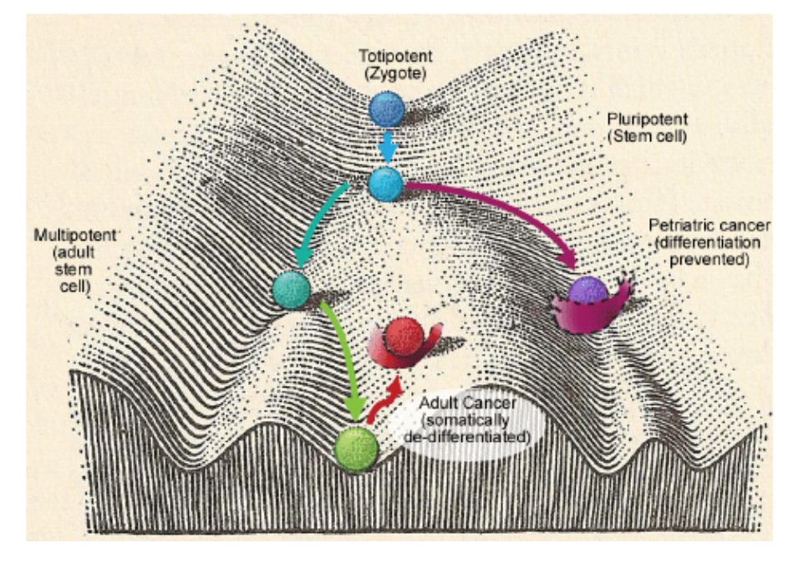
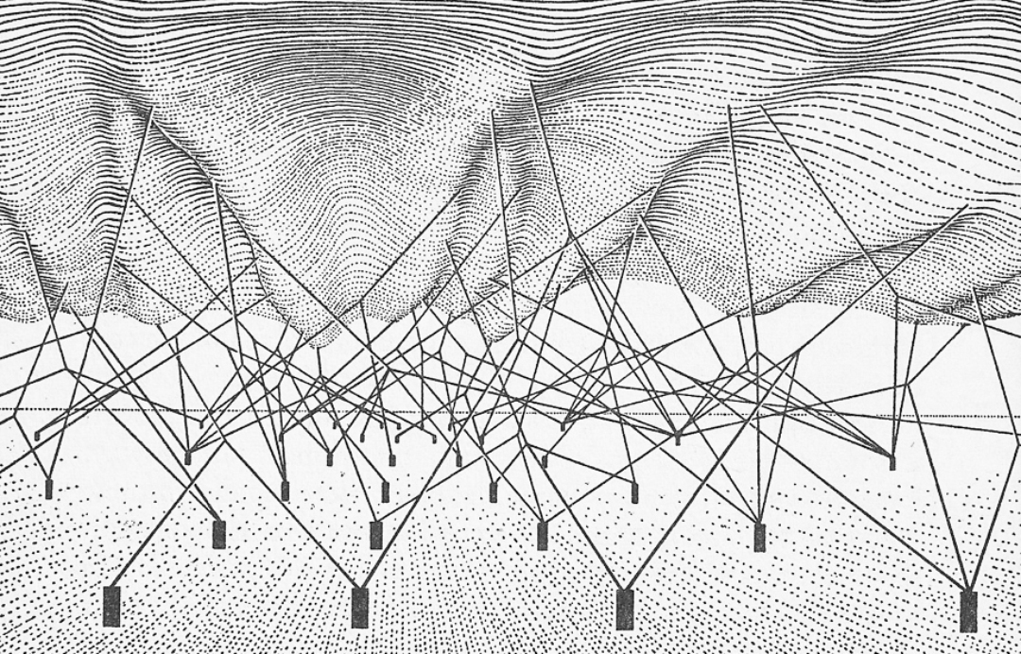
Networks in gene expression analysis
Waddington’s Epigenetic Landscape, 1940
Notes:
Why networks?
You might recall this image from Session 2. Krishna used it to illustrate the nonlinear transitions between types of cell. The reason it looks like an old hand-made wood print, is because it is. It’s an illustration from 1940. Waddington paired this image with another image [CLICK] meant to explain what underlies the undulating surface… It’s a network!... We don’t have the data nor the algorithms to directly infer these networks just from sequencing RNA from cells, but we do have methods to generate reasonable hypothetical networks that might explain the cell type transitions we observe. That’s where scNetViz comes in.

Slide 4
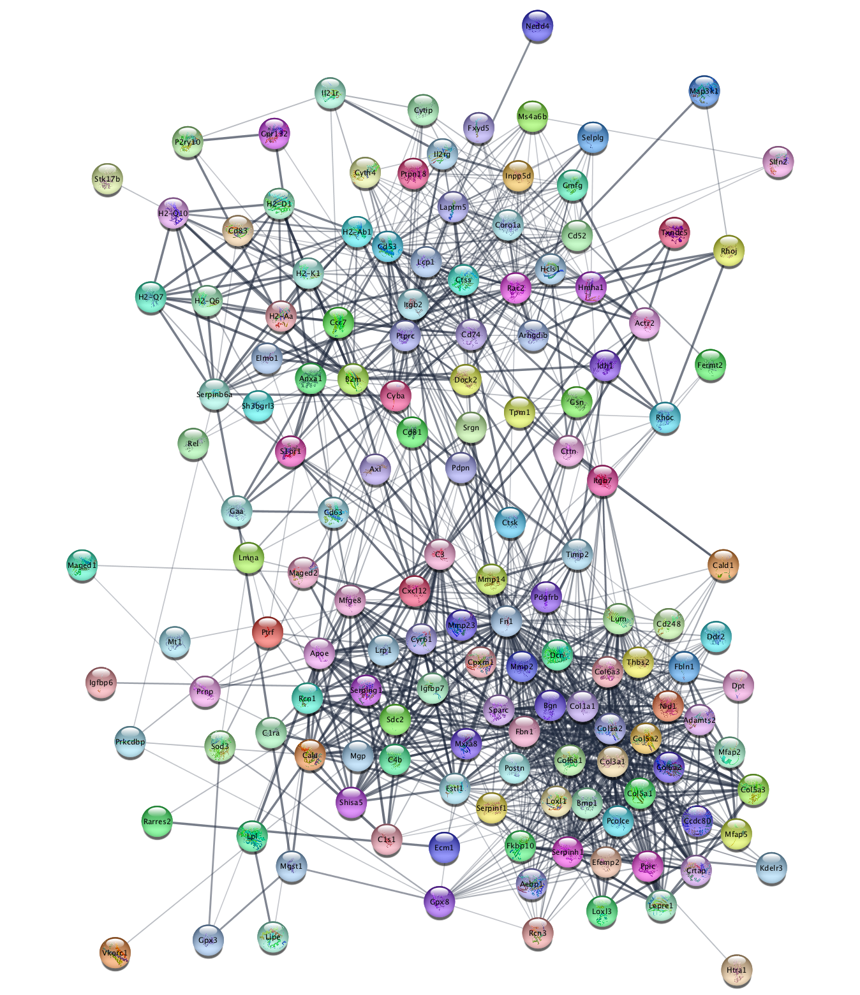
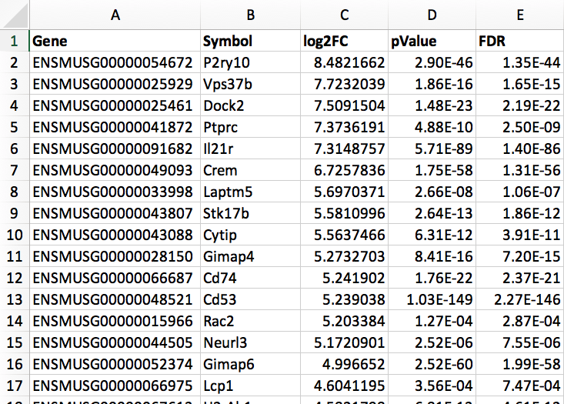

Networks in gene expression analysis
Gene lists + interaction database = networks
+
=

Slide 5
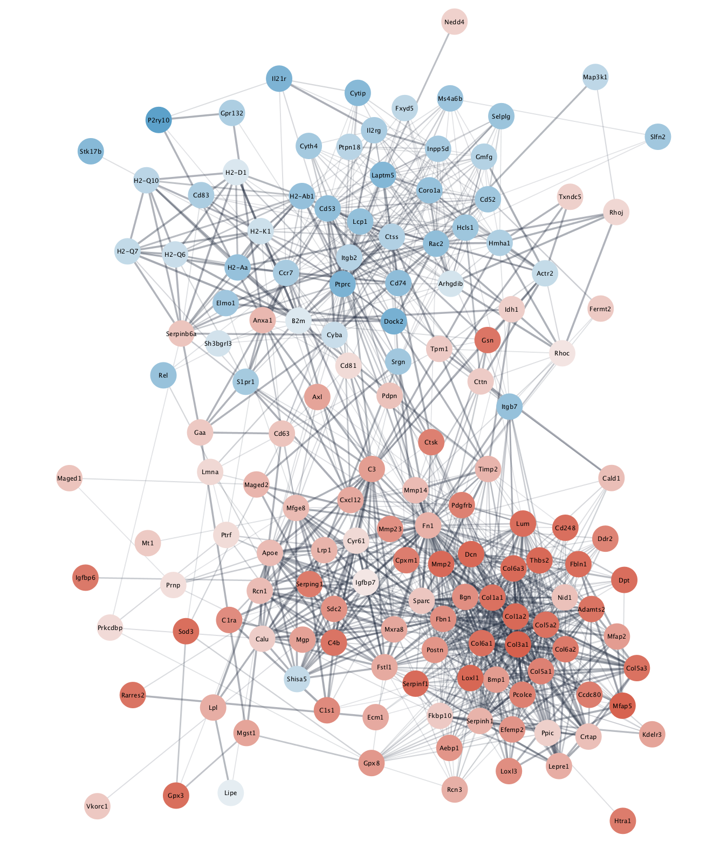
Networks in gene expression analysis
Overlay expression data onto network
+
=

Slide 6
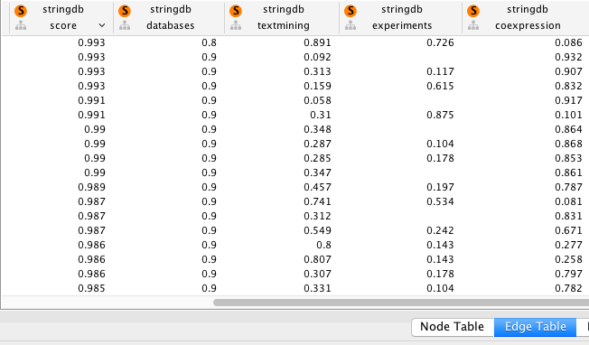
Networks in gene expression analysis
Weighted interactions by evidence type

Slide 7
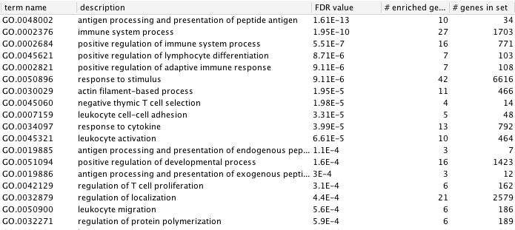
Networks in gene expression analysis
GO analysis on relevant parts of network

Slide 8
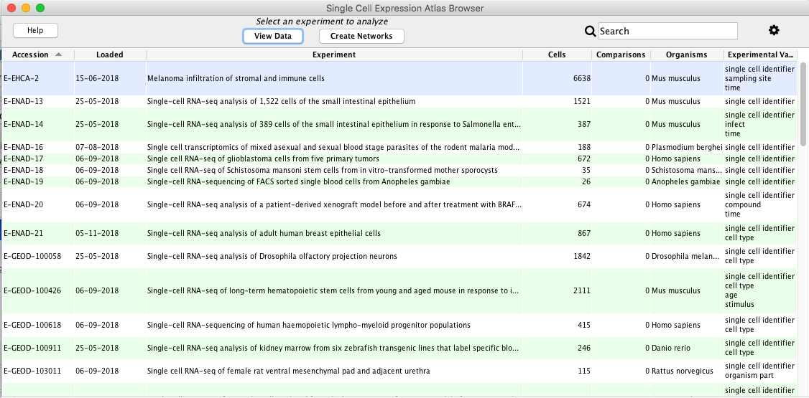
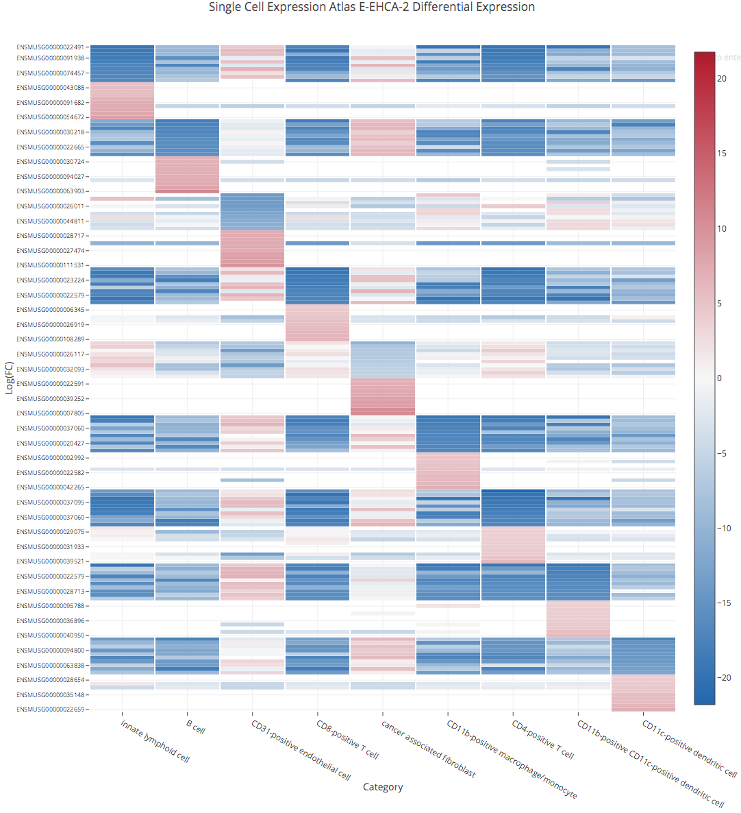
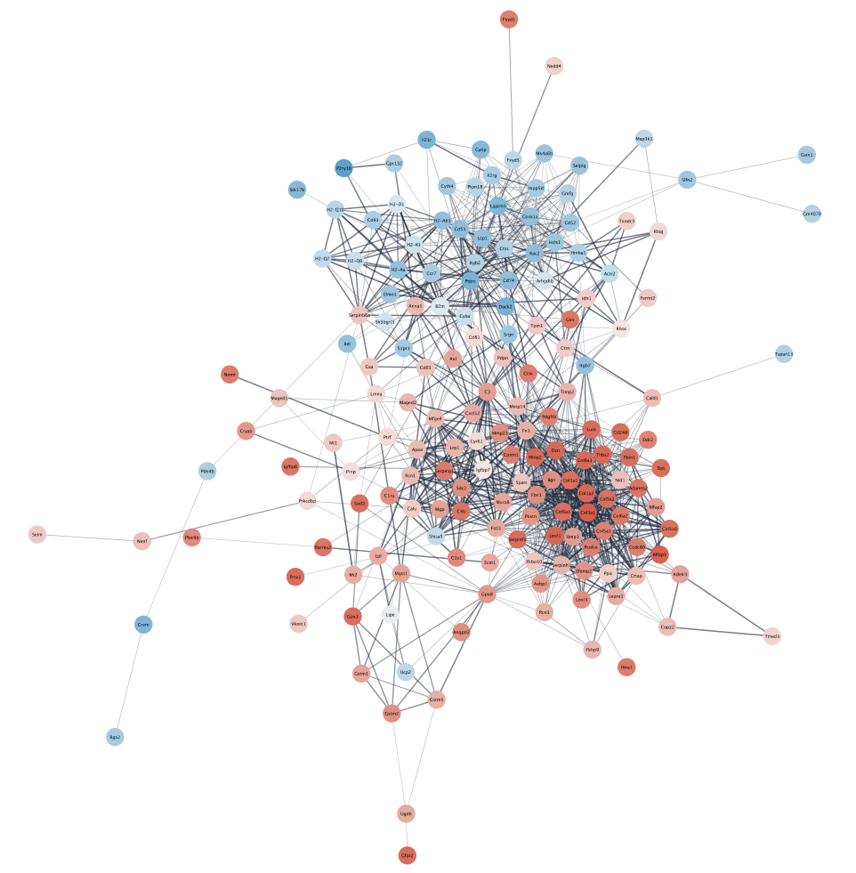
scNetViz Overview
Browse available datasets
(or import your own)
Select available clusters or categories (or import your own)
Perform DE and find top genes
Construct networks and perform enrichment analysis
Notes:
In this section of the workshop we will introduce a new tool for single cell RNA-seq analysis developed here at the Mission Bay campus, called scNetViz

Slide 9
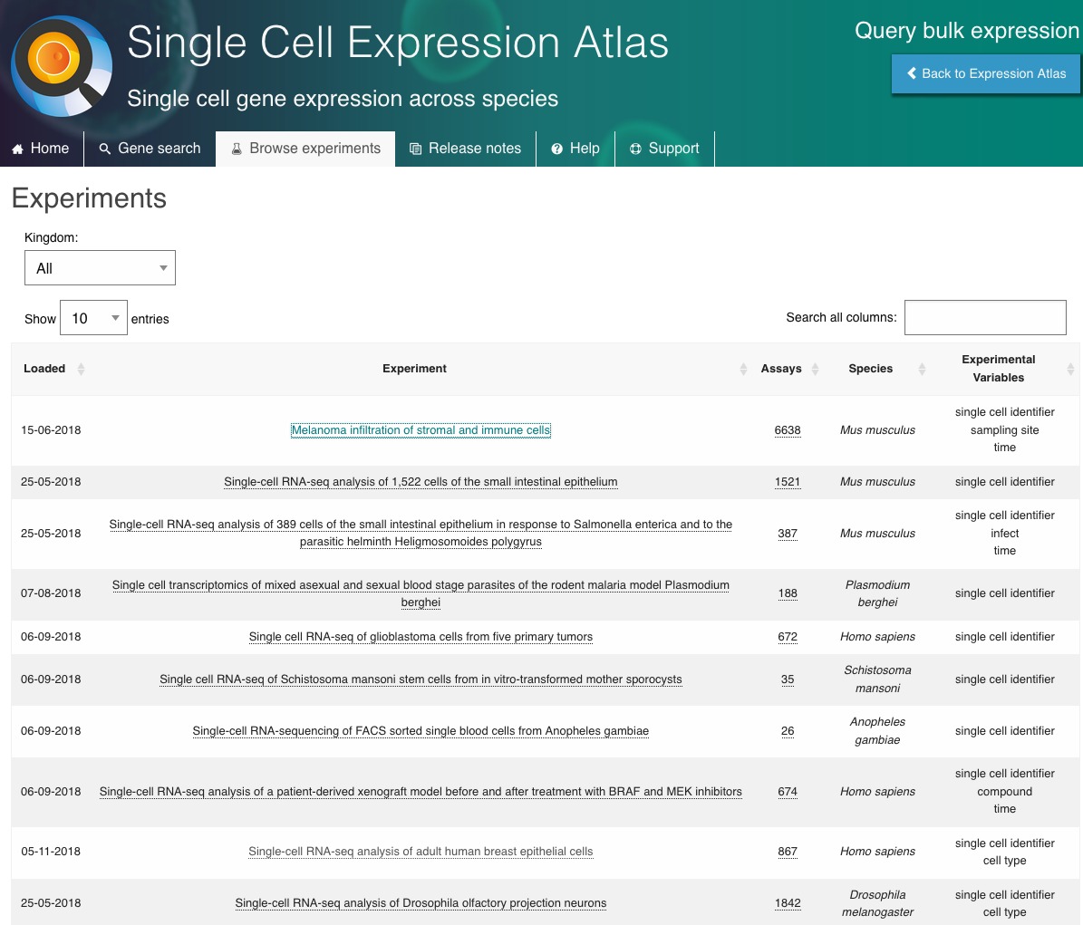
Notes:
Show EBI interface first

Slide 10
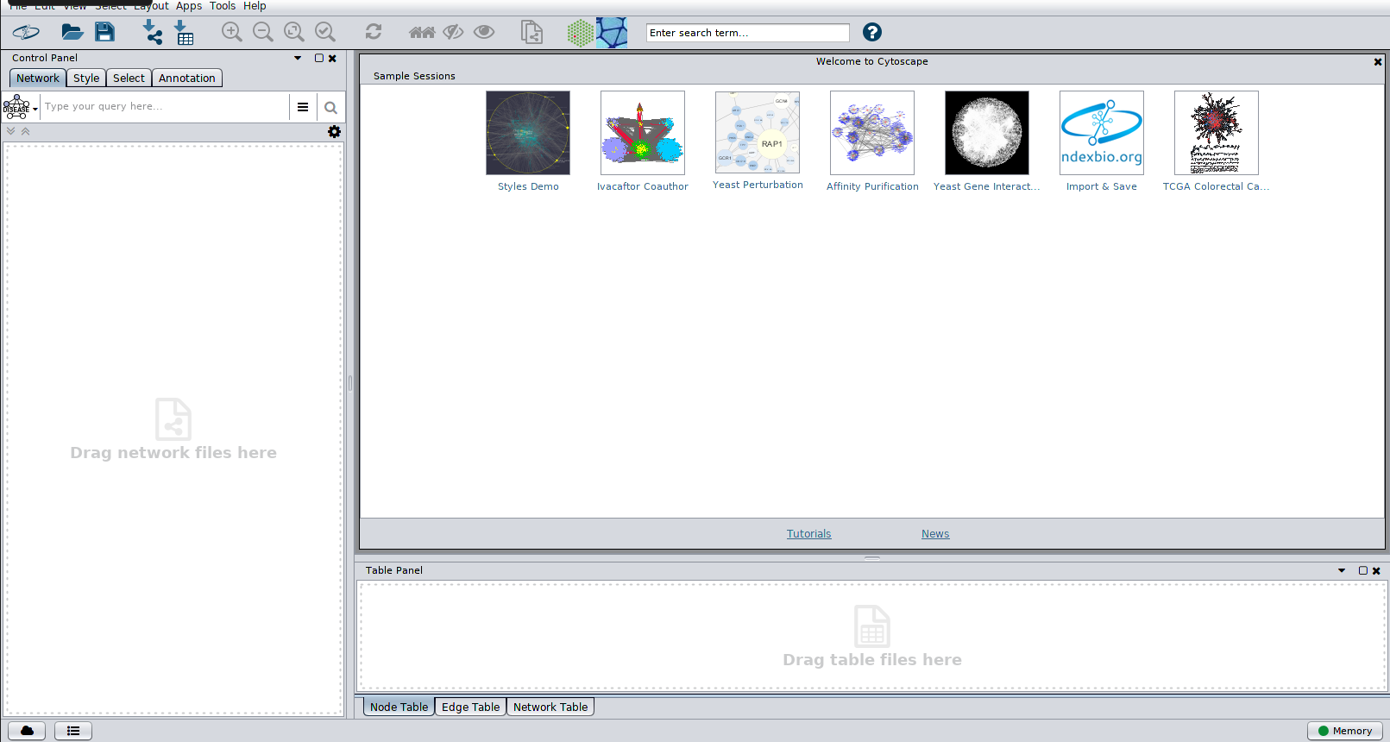
Notes:
Show EBI interface first

Slide 11
Notes:
Show EBI interface first

Slide 12
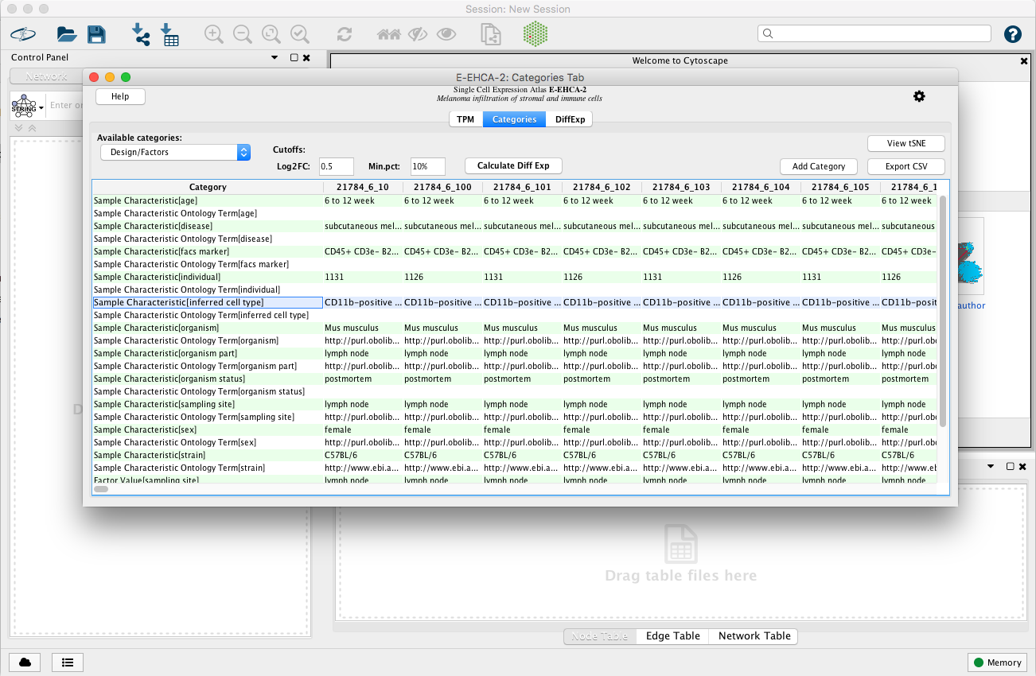
scNetViz: perform differential expression
Notes:
Pre-calc DE on own, so you can poke around Cytoscape
Q&A
Note: Local vs EBI category files
Show heatmap
Visit: scNetViz docs

Slide 13
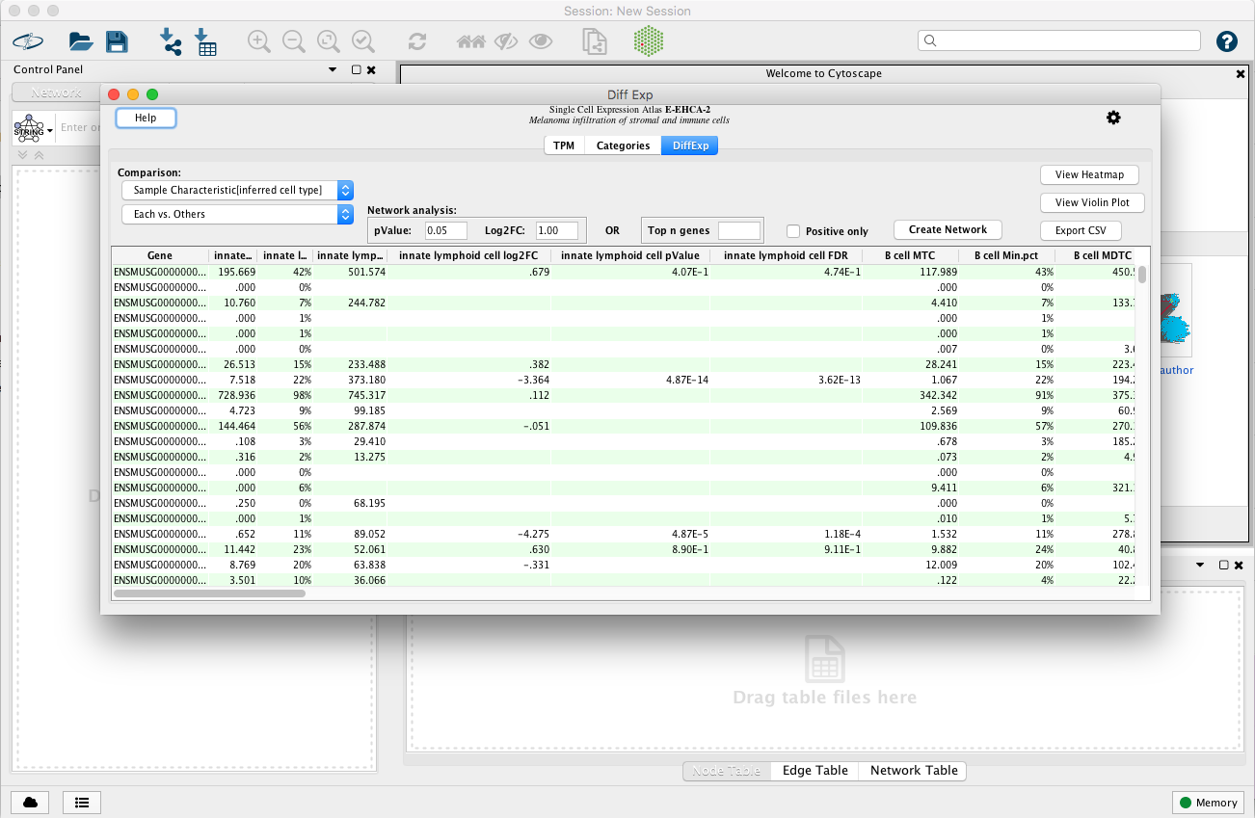
scNetViz: view results

Slide 14
Notes:
Walk though heatmap columns, rows
Make some interpretations: down/up, marker genes? (by design)

Slide 15
scNetViz: generate networks

Slide 16
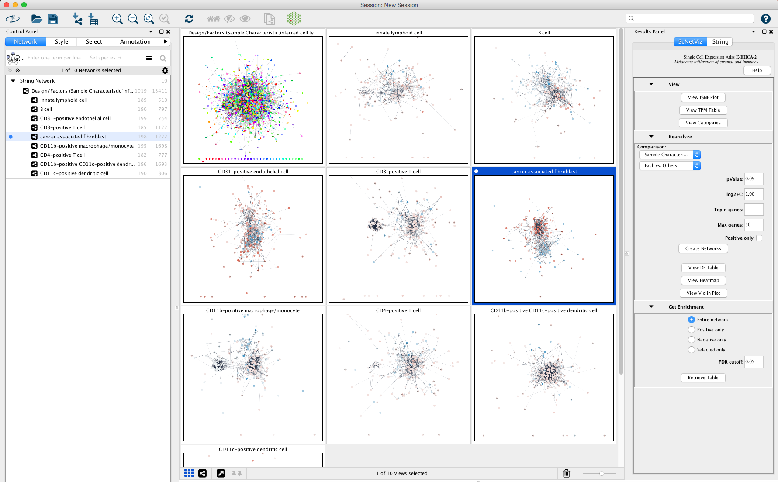
scNetViz: explore networks

Slide 17
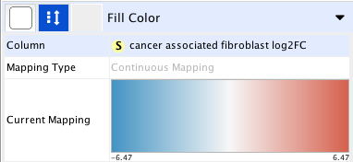
scNetViz: explore networks
Inferred Cell Type:
Cancer associated fibroblast

Slide 18
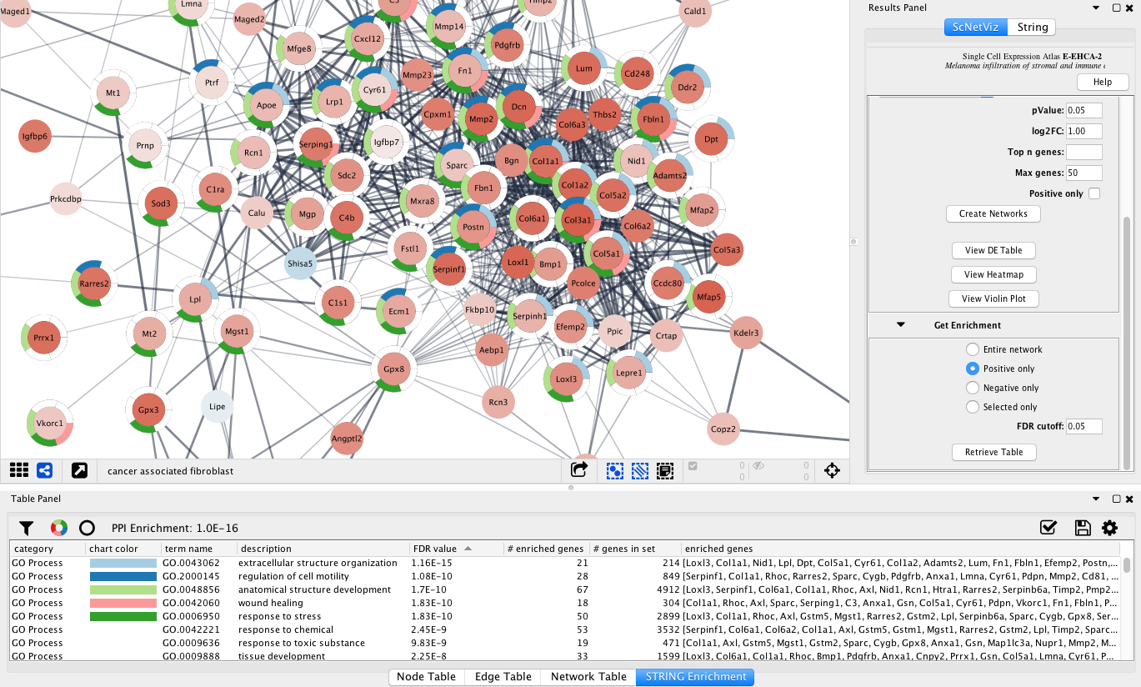
scNetViz: from atlas to networks

Slide 19
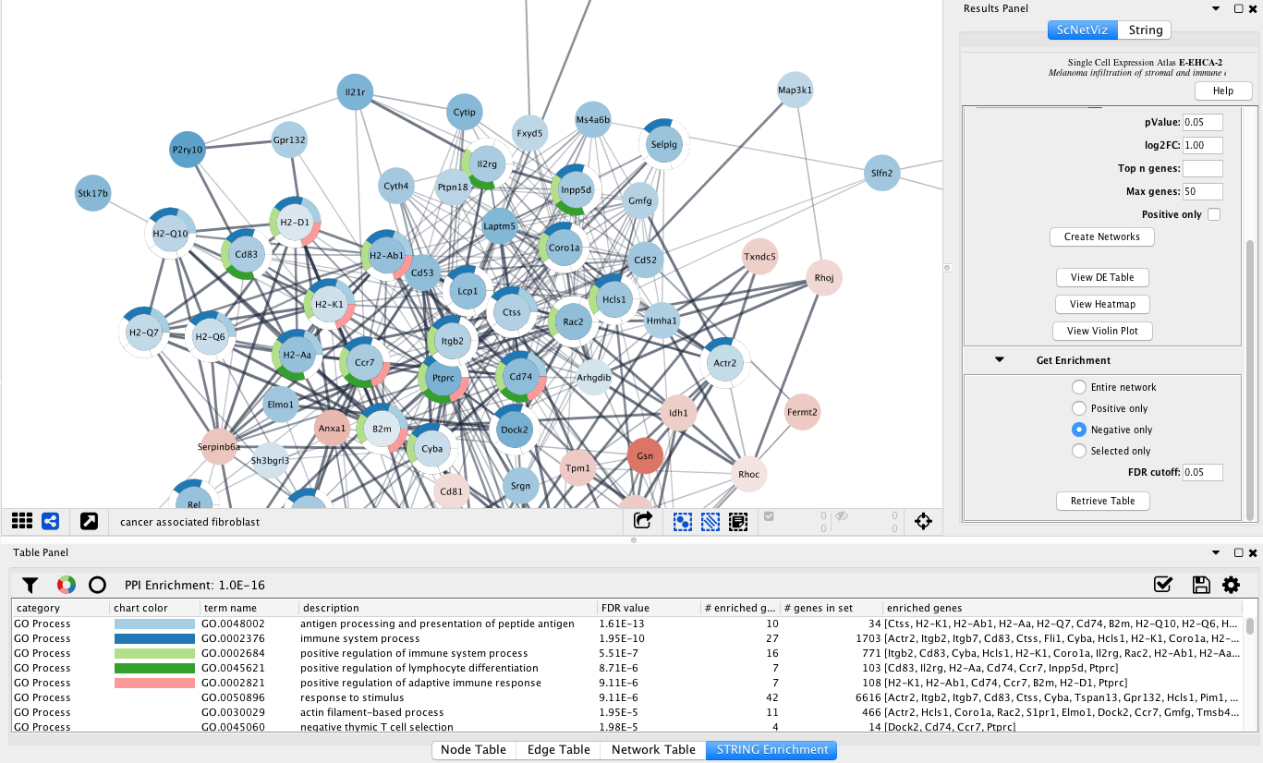
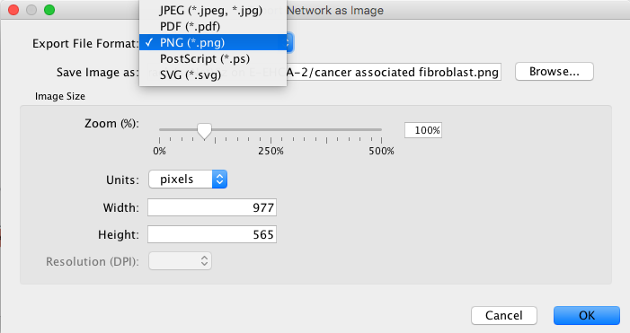
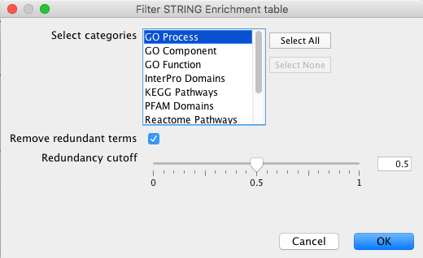
scNetViz: from atlas to networks

Slide 20
Wrap up
From normalized scRNA-seq datasets to networks and function
EBI Single Cell Expression Atlas and CZI Human Cell Atlas
scNetViz in Cytoscape
Browse available datasets (or import your own)
Select available clusters or categories (or import your own)
Perform DE and find top genes
Construct networks from STRING interaction database
Perform enrichment analysis on gene sets within cell populations
Export tables, plots and networks with data overlays

